Slide 1
BLIND WALK
An evolution of Zombies
Walk
eat
elimination
evolution

Slide 2
CONTENTS
1
1
Overview
Overview
2
Key Operations
3
Result Analysis
4
Summary

Slide 3
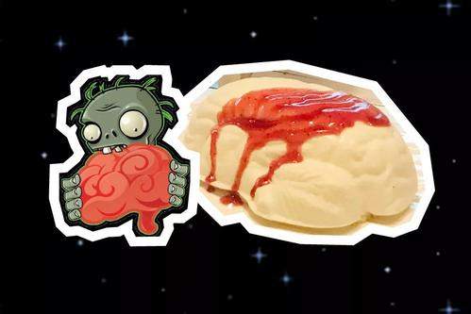
Overview
Overview
Our program is to design a little circumstance that bases on the game Plants vs. Zombies. A zombie who wants to eat brain being born randomly in a 10x10 map.
1
点击添加标题

Slide 4
Amounts
50
The border
100
1
1
点击添加标题
Brains
The zombie will lose
1 point When it choose to eat in
a place without brain or get 10 points
when it eat the brain successfully.
Spikeweeds
The zombie will lose 5 points when
it walks on the spikeweeds.
Square
There are 100 squares
in the map in total.
Zombie
There will be a zombie
randomly appear in the
map and walk to eat.

Slide 5
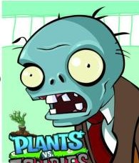
Zombie Actions
Zombie Actions
The zombie’s actions include moving up, moving down, moving left, moving right, eating brain and keeping still. It can know the situations of its surroundings. One zombie can only move 200 steps.
1
点击添加标题

Slide 6
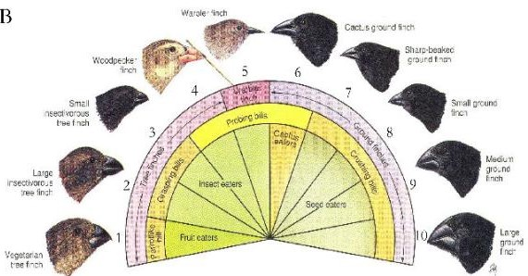
Our purpose
1.Populate individuals and change them.
1
点击添加标题
2.Do elimination and make evolution.
3.Find the best and the result of evolution.

Slide 7
CONTENTS
1
Overview
2
2
Key Operations
Key Operations
3
Result Analysis
4
Summary

Slide 8
Key Operations
1
点击添加标题
Make Individuals
Do Elimination
Cross Over
Mutation
Get the best
The flow of the evolution

Slide 9
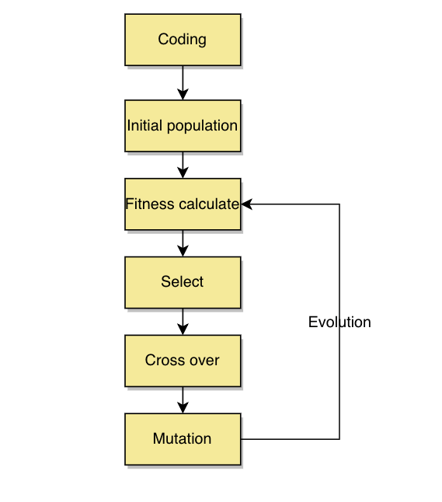
Flow Chart
Nature selection and evolve
Initial population: 1000 individuals
Fitness calculate: Get the initial fitness of individuals.
Select: Eliminate the individuals according to probability periodically.
Cross Over: Happens in the process of the mating between the mature individuals. And the gene get changed.
Mutation:Happens in the process fo the mating too. Because of the crossing over and mutation, the good genes can be generate and keep.
1
点击添加标题

Slide 10
That is:
Initial Population
Select
mutation
1
点击添加标题
Repeat
Fitness Calculate
Cross Over

Slide 11
CONTENTS
1
Overview
2
Key Operations
3
Result Analysis
3
Result Analysis
4
Summary

Slide 12
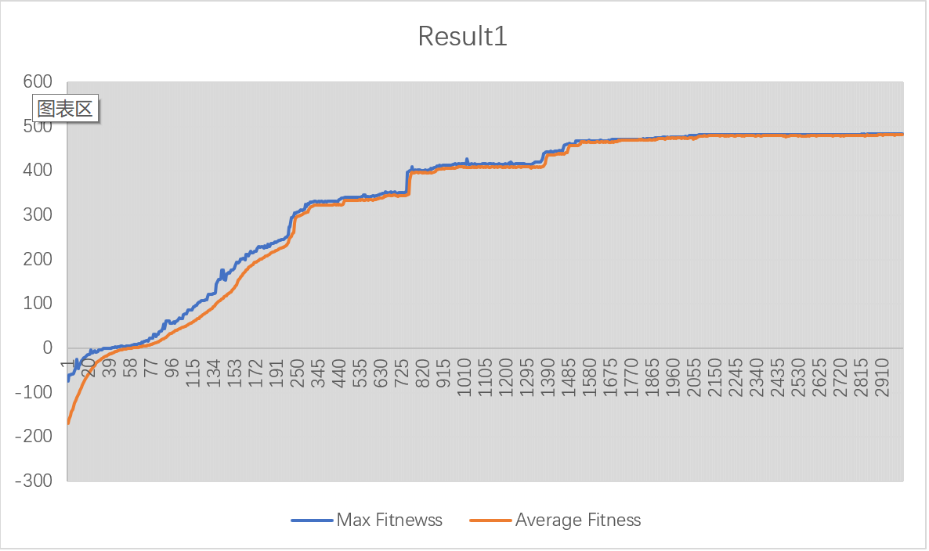
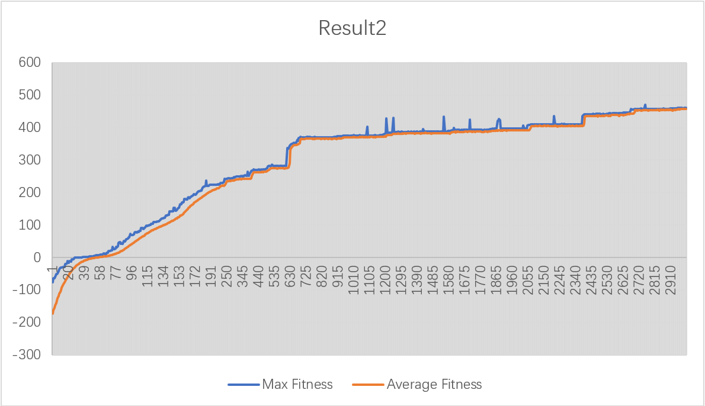
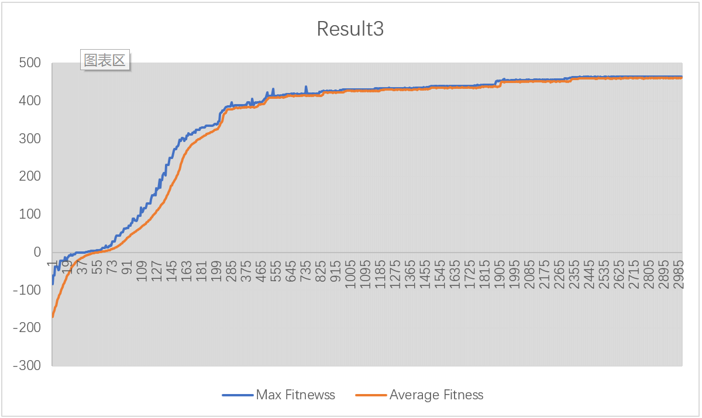
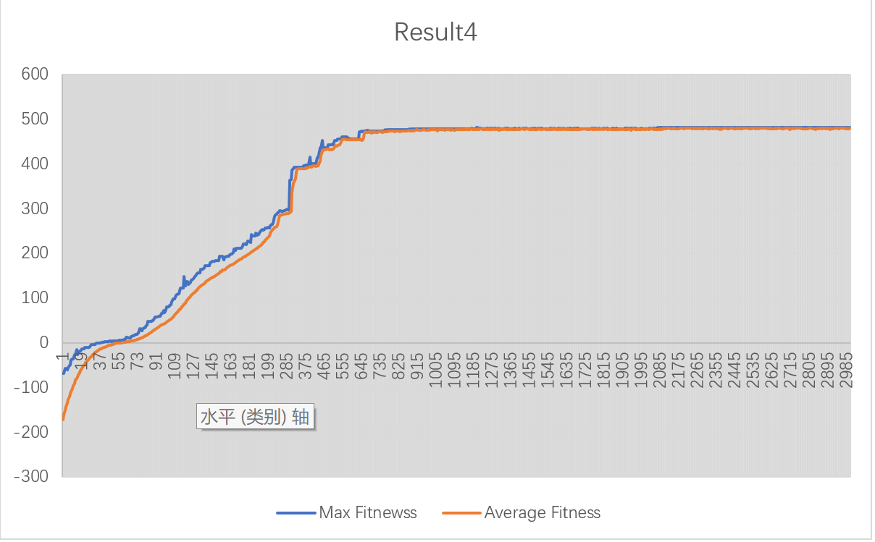
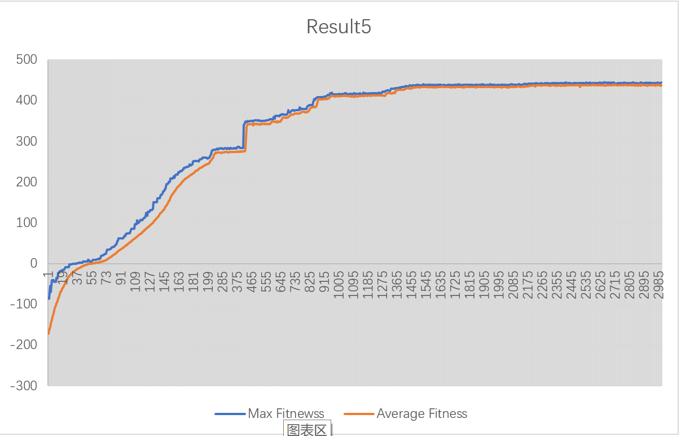
Results
1
点击添加标题

Slide 13
Results
480
In the five cases, the maximum value is 480 points, and the results of the five experiments tend to a fixed maximum value and then stabilize, which should be the best zombie under multi-round elimination.
1
点击添加标题
470
460
450
436
Case1
Case2
Case3
Case4
（best）
Case5

Slide 14
Analysis
Analysis
There are 243 kinds of states and each state has its own action. All of these things organize a path for a zombie. The population of zombies in the experiments is 1000. That means we have 1000 different kinds of zombies. Every zombie has its own gene(walk guide). In the system, we let them can only walk 200 steps and get their map states and birthplace states. What’s more, there are 1000 simulations in this system. As a result, we can find the zombie who can really adapt to the 1000 different states of map and birthplace.
1
点击添加标题

Slide 15
CONTENTS
1
Overview
2
Key Operations
3
Result Analysis
4
Summary
4
Summary

Slide 16
Population size
<Amount>
1
Population amount:1000
Select Process
点击添加标题
1000
When the algorithm is selecting the individuals according to the probability, the amount of the population become less than before.
800
Population amount:500
600
400
Populate Process
200
Almost at the same time, the populating process is on. This process keep the population as a whole at 1000.
0
<Time>
Select Process
Populate Process

Slide 17

Summary
Summary
In the diagrams above. We can find the increasing of the fitness is getting slowly. In that case, we can draw a conclusion that the fitness will reach 500 if we run enough evolving times. Because the best zombie can eat all of 50 brains without losing points. We can also find there are abrupt changes in the result diagram. The reason of that is there are mutations in my algorithm. These mutations are good for the zombie to become better.
1
点击添加标题

Slide 18
THANKS !
Team member:
LY.Wang
FT.Guo
J.Li

